Slide 1
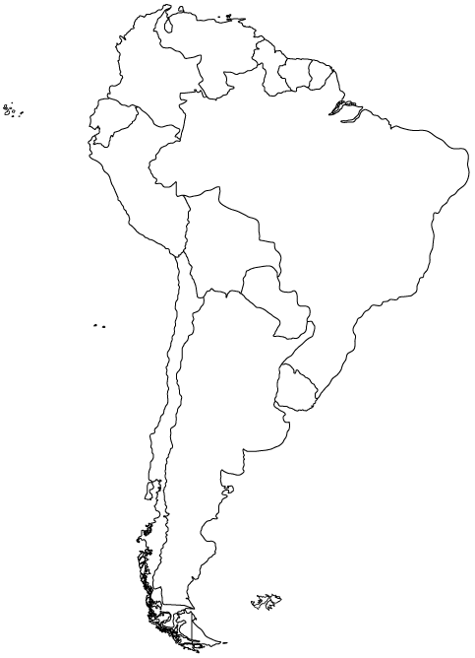
Name ___________________________________ Date ______________ Period ______
Uncontacted Tribes Discovered in Brazilian Amazon
Meaningful quote from the reading:
What reservation do the tribes live on? (Circle the area, draw a line to it, & label surrounding countries)
How do they estimate the population of the tribes?
What threats do the tribes face? How might they be effected if these threats actually make contact with them?
How do you think these tribes managed to live in the Amazon with no contact with the outside for so long?

Slide 2
What’s your opinion?
Do you think that the outside world should make contact with these tribes? Explain your answer using evidence from the article.
Thinking about the other point of view…
What might somebody with an opposing opinion say? What might their arguments be? Who might they be?

