Slide 1
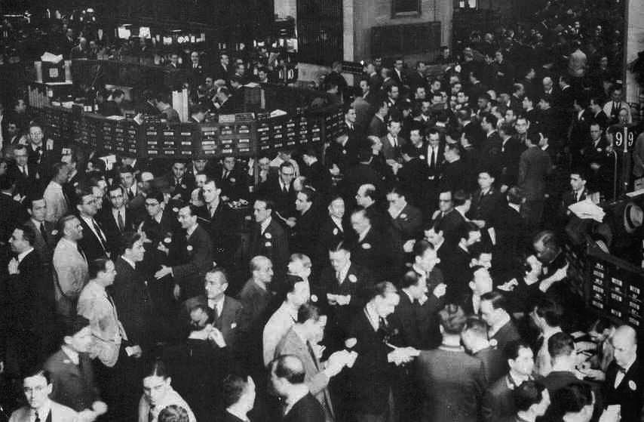
Role-Playing the 1920s

Slide 2
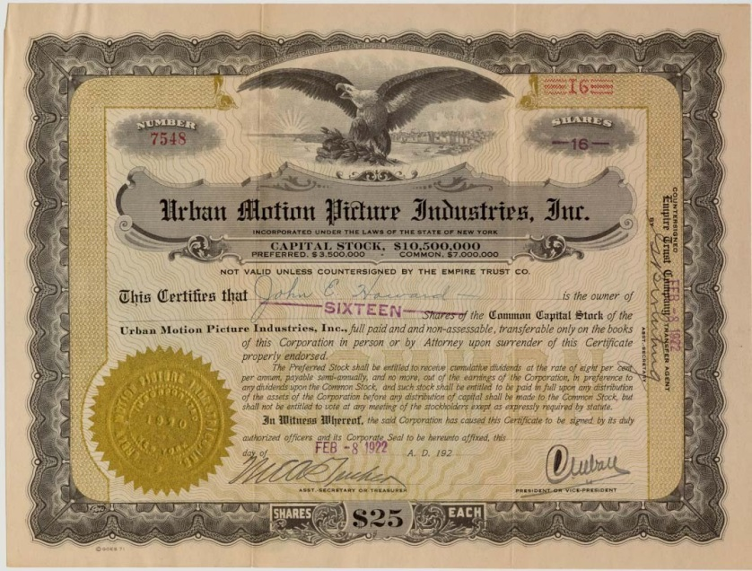
What is a stock?
Represents a share in
ownership of a company.
10 shares make up one
stock today
Profits increase when a
company is doing well, and
decrease when a company is failing.
What is a stock exchange?
A public market where stocks are sold and bought between brokers (buyers) and traders.
The most famous stock exchange is the New York Stock Exchange (NYSE) on Wall Street in New York City.

Slide 3
Your goal today is to make as much money as possible to live out the Roaring Twenties to the fullest.
Your team will begin with $1000 to invest and buy stocks.
Work together with your team to make decisions.
Each stock costs $100.
You may invest everything in one company, or in many.
The winning team will receive a prize!

Slide 4
To Buy/Sell
A stockbroker is someone who buys and sells stocks in stock exchanges.
A few students each period have been selected as stock brokers. When the stock exchange is open, you will have five minutes to buy or sell stock from the stock brokers.
Each stock certificate is 10 shares, or $100.

Slide 5
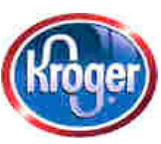
1920s Companies
Kroger Foods
A newly established regional food processing company. It deals basically in fruit and tomato products. It has recently offered share to the public and it has been listed on the exchange for just one week.
If successful, Kroger Foods could be an excellent money maker with national markets, however food industries always depend on good crops.

Slide 6
1920s Companies
Radio Corporation
This company has long been considered one of the better buys in the field of electronics.
Market experts see this corporation as a good, long term investment, which is safe and provides security for its stockholders.
The future of Radio Corporation will depend on its new models.

Slide 7
1920s Companies
Mammoth Oil
Owned and operated by Harry Sinclair who is rumored to have the backing of influential government employees.
Mammoth has borrowed large sums of money to explore for oil.
The value of Mammoth Oil stock has fluctuated between 20¢ and $5 a share for the past two years.

Slide 8
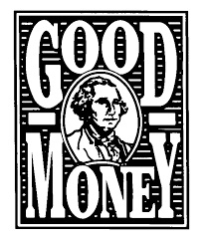
1920s Companies
Gotham Bank
One of the oldest, wealthiest, and most conservative financial houses in the country.
This stock is so stable that when it once dropped two points in a week, back in 1893, it set off a small-scale recession.
This bank has paid an annual dividend for 130 years.

Slide 9
1920s Companies
Durant Motors
This corporation was founded by a carriage maker in Flint,Michigan.
The company is attempting to produce a low cost car and plans to produce a car with a “self starter.”
Durant Motors presently produces the Locomobile, the Durant-Four and the Flint.

Slide 10
1920s Companies
Midland Utilities
Owned and operated by financial genius Samuel Insull.
Midland is part of a billion-dollar corporation operating in 32 states.
Midland produces electricity for central Chicago and is expanding into the suburbs. Midland is one of the most powerful corporations in the Midwest.

Slide 11
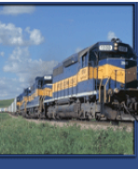
1920s Companies
Kansas-Pacific Railroad
The K&P has been in existence for over 60 years. While many railroads are faced with declining profits, the K&P shows a steady increase.
They are presently expanding into the Southwest and plan to extend their holdings into Mexico.

Slide 12
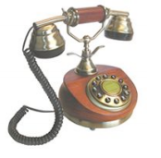
1920s Companies
Tel-Tone
This telephone company is just beginning. This is their first public offering of stock.
They presently plan to manufacture a dial-telephone. This process reportedly will revolutionize the use of the telephone.
Their management is young and inexperienced.

Slide 13
Stock | Opening Price | 1920 | 1922 | 1923 | 1927 | 1928 | 1929
Kroger | $10
Radio Corporation | $10
Mammoth Oil | $10
Gotham Bank | $10
Durant Motors | $10
Midland Power | $10
Kansas & Pacific | $10
Tel-Tone | $10

Slide 14
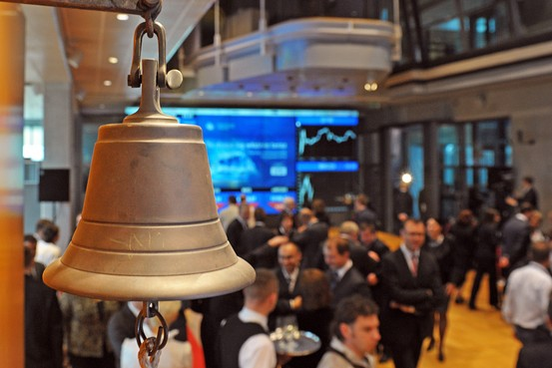
Stock Market Opens
You have five minutes to buy or sell.
http://www.youtube.com/watch?v=qr6gOTEptWo

Slide 15
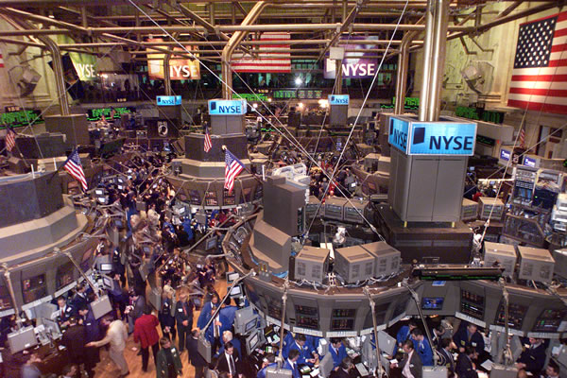
Stock Exchange Closes
http://www.youtube.com/watch?v=qr6gOTEptWo

Slide 16
1920
Outcome | New Market Share
Kroger: purchases new food chain | $12
Radio Corporation: new antenna model | $13
Mammoth Oil: 9 new wells drilled | $14
Gotham Bank: Bank Declares a 6% dividend | $11
Durant Motors: defaults on bank payment | $7
Midland Utilities: extends to MI and WI | $13
Kansas Pacific: Expanded to Southwest | $9
Tel-Tone: Dial telephones installed in NYC | $15

Slide 17
Stock Market Opens
You have five minutes to buy or sell.
http://www.youtube.com/watch?v=qr6gOTEptWo

Slide 18
Stock Exchange Closes
http://www.youtube.com/watch?v=qr6gOTEptWo

Slide 19
1922
Outcome | New Market Share
Kroger: merges with Eastern stores | $15
Radio Corporation: purchases 15 patents | $14
Mammoth Oil: largest oil field in US discovered | $19
Gotham Bank: Stock Remains the Same | $11
Durant Motors: competing with Ford | $5
Midland Utilities: takes control of Edison Electric | $19
Kansas Pacific: Agricultural shipments to Southwest begins | $10
Tel-Tone: Greatest increase of any stock listed on the exchange | $22

Slide 20
Special News Bulletin
President Harding is suffering from a seizure and is reported to be dying.
You have two minutes to buy or sell.

Slide 21
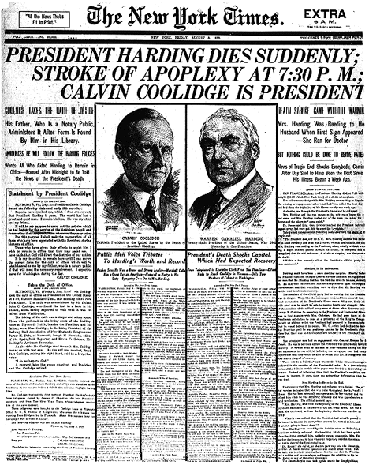
Special News Bulletin
August 2, 1923
President Harding dies. Calvin Coolidge sworn is as President.
Stocks will close immediately

Slide 22
Stock Exchange Closes
http://www.youtube.com/watch?v=qr6gOTEptWo

Slide 23
1923: Emergency Closing
Outcome | New Market Share
Kroger | $13
Radio Corporation | $13
Mammoth Oil | $16
Gotham Bank | $10
Durant Motors | $4
Midland Utilities | $19
Kansas Pacific | $9
Tel-Tone | $19

Slide 24
Stock Market Opens
You have five minutes to buy or sell.
http://www.youtube.com/watch?v=qr6gOTEptWo

Slide 25
Stock Exchange Closes
http://www.youtube.com/watch?v=qr6gOTEptWo

Slide 26
1925
Outcome | New Market Share
Kroger: Corn blight kills 90% of crop | $12
Radio Corporation: Speculation on new patent causes prices to rise | $15
Mammoth Oil: Japanese offer to buy the total production of Elk Hills well | $21
Gotham Bank: French Gov. announces they will start paying back WW1 loans to US Banks | $12
Durant Motors: The DuPont family begins to buy large blocks of Durant | $7
Midland Utilities: Fears Cyrus Eaton of Cleveland may be trying to take over Midland by purchasing large amount of stock | $22
Kansas Pacific: Speculations on profits from holdings in Mexico cause price to rise | $11
Tel-Tone: Announce successful merger | $24

Slide 27
1927
Outcome | New Market Share
Kroger: speculation that Purity Markets may take over Kroger | $14
Radio Corporation: rumored merger with Edison company causes stocks to rise | $17
Mammoth Oil: investigated by Congress for possible fraud | $13
Gotham Bank: Stock remains unchanged | $12
Durant Motors: Louis Chevrolet is hired to design a cheap automobile | $10
Midland Utilities: large stocks sold by main shareholder | $18
Kansas Pacific: Drought in Southwest | $10
Tel-Tone: J.P. Morgan sells off large amount of shares. Brokers see dip as temporary | $22

Slide 28
Stock Market Opens
You have five minutes to buy or sell.
http://www.youtube.com/watch?v=qr6gOTEptWo

Slide 29
Stock Exchange Closes
http://www.youtube.com/watch?v=qr6gOTEptWo

Slide 30
1928
Outcome | New Market Share
Kroger: Agricultural surpluses cause food prices to drop | $13
Radio Corporation: merger fails with Edison Company | $14
Mammoth Oil: Sinclair charged with fraud | $7
Gotham Bank: Announce profits have increased 5% last quarter | $13
Durant Motors: Merger with Fisher Body creates General Motors | $13
Midland Utilities: Chicago Tribune calls company a “House of Cards” that is “Ready to Crumble” | $14
Kansas Pacific: New oil fields in Oklahoma booming | $12
Tel-Tone: Fails to meet expectations. No explanation. | $17

Slide 31
Special News Bulletin
WEDNESDAY, OCTOBER 23, 1929:
Home construction, an indicator of prosperity, is at an all time low.
It is rumored that the House of Morgan intends to sell 12 million shares of common stock at a loss, before interest rates change.
The Gotham Bank announced that margin buyers of stock are being notified that they must put up more money to cover today’s losses.

Slide 32
Stock Market Opens
You have five minutes to buy or sell.
http://www.youtube.com/watch?v=qr6gOTEptWo

Slide 33
Stock Exchange Closes
http://www.youtube.com/watch?v=qr6gOTEptWo

Slide 34
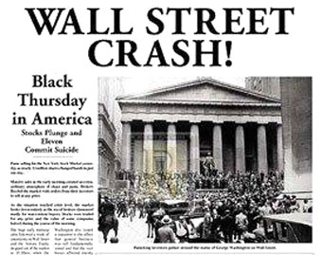
Special News Bulletin
Thursday, October 24, 1929

Slide 35
Special News Bulletin
THURSDAY, OCTOBER 24, 1929:
Panic hits Wall Street. 12 million shares are traded in one day on the New York Exchange. $700 million is lost by stock holders in one day as the market takes the greatest dive in history.

Slide 36
Black Thursday Please total up your net worth Multiply the amount of stock you own by the stock prices and add in any cash you have on hand.
Outcome | New Market Share
Kroger | $8
Radio Corporation | $4
Mammoth Oil | $2
Gotham Bank | $12
Durant Motors | $12
Midland Utilities | $3
Kansas Pacific | $8
Tel-Tone | $6

Slide 37
Simulation is over!!!!
Please total up your net worth
Multiply the amount of stock you own by the stock prices and add in any cash you have on hand.

