Slide 1
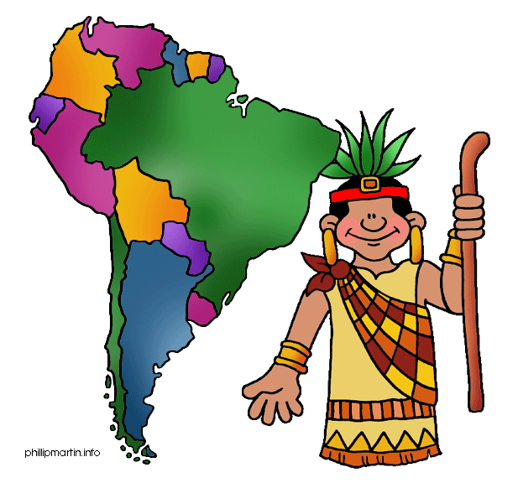
South America

Slide 2
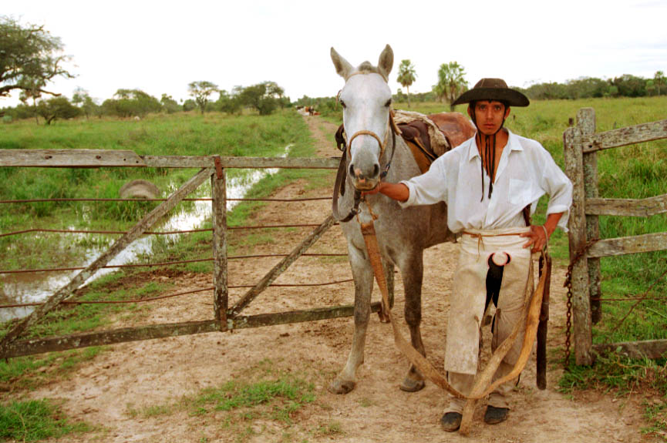
Facts & Vocabulary
4th largest continent in size
5th largest in population
Estuary—broad river mouth where a river valley meets the sea
Piedmont—foothills region
Pampas—temperate grasslands where grains grow
Gauchos—cowboys

Slide 3
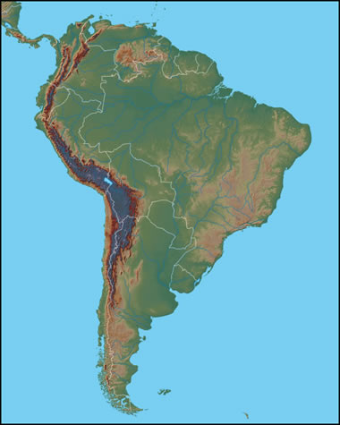
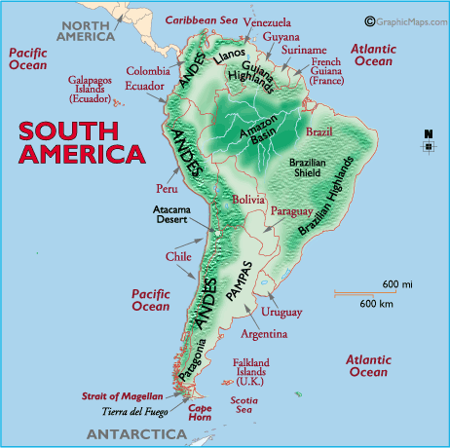
The Andes are the longest mountain range in the world and, the 2nd highest mountains in the world.
ANDES MOUNTAINS

Slide 4
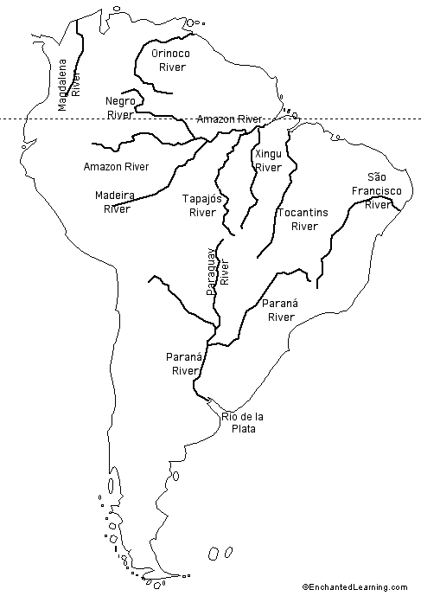
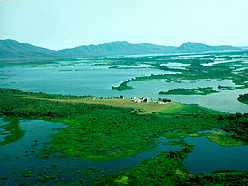
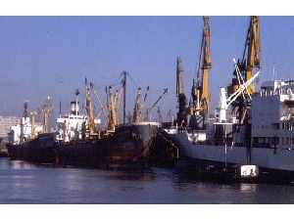
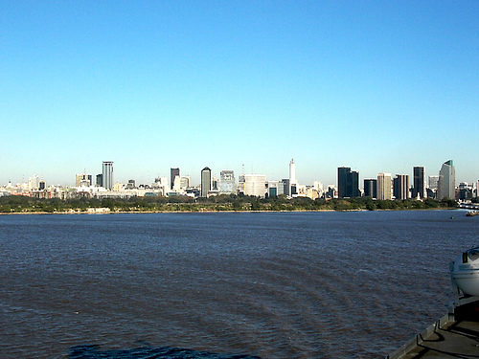
Rio de la Plata
The Rio de la Plata (River of Silver) is actually made up of the Paraguay, Uruguay and Parana rivers. It is the widest river in the world It serves as a major shipping route. Buenos Aires, Argentina is the world’s second busiest port.

Slide 5
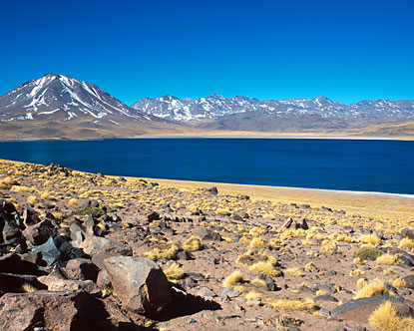
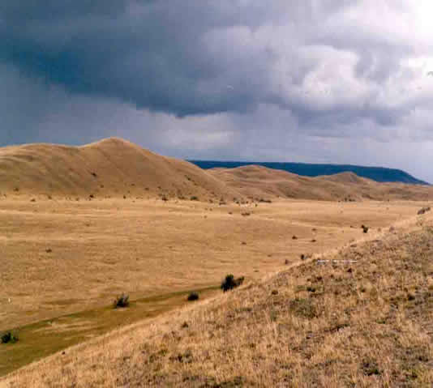
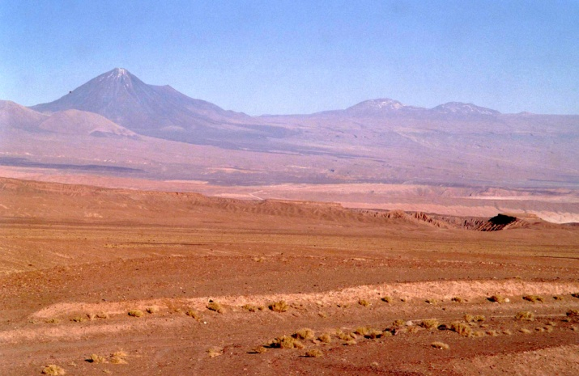
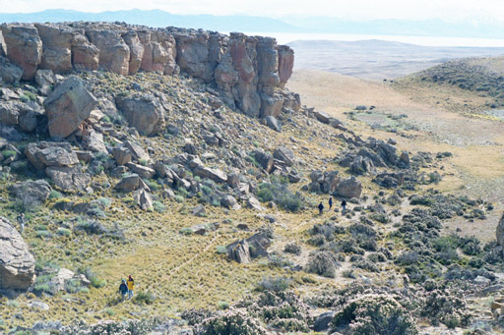
Dry Climate
Atacama Desert, Chile
Patagonian Plateau, Argentina and Chile
The Atacama is one of the driest places on Earth. In some parts no rain has fallen for 400 years.

Slide 6
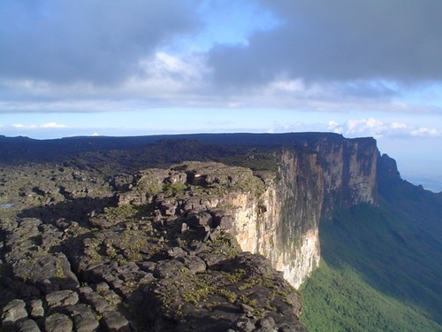
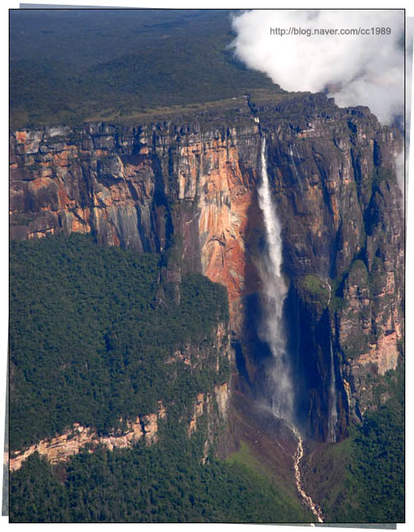
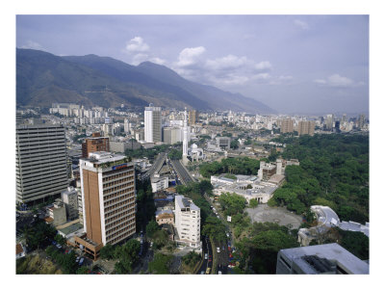
GUIANA HIGHLANDS

Slide 7
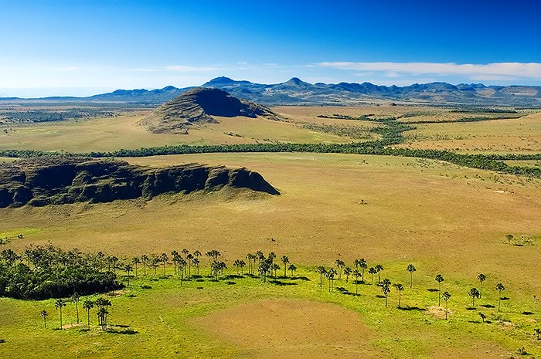
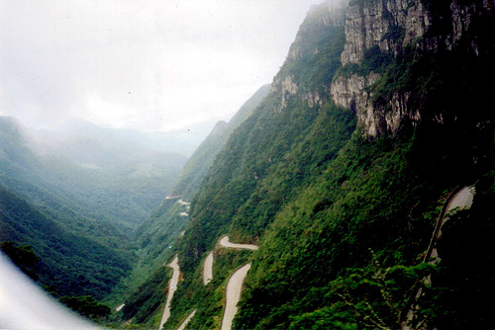
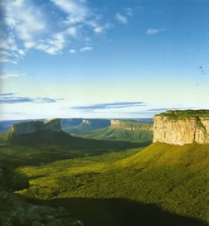
BRAZILIAN HIGHLANDS

Slide 8
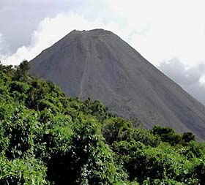
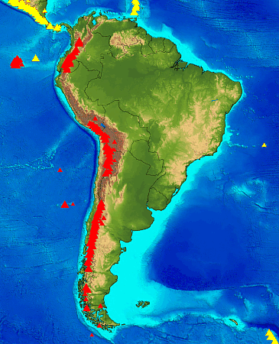
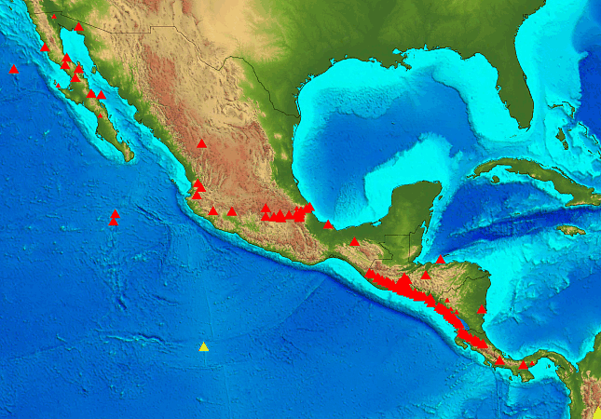
VOLCANOES

Slide 9
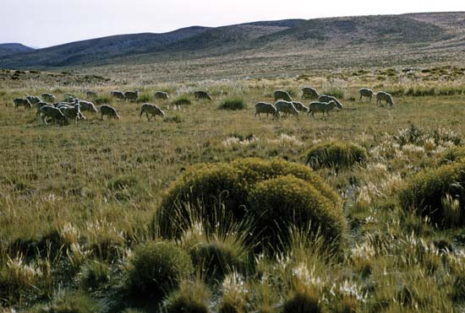
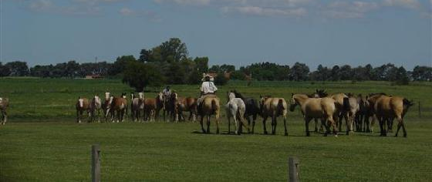
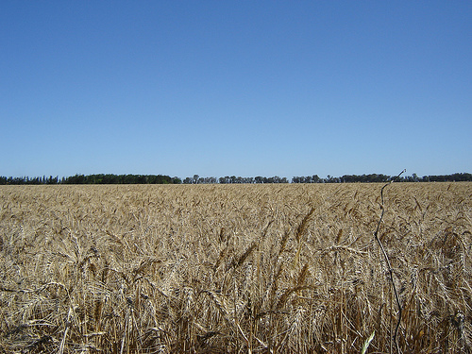
LOWLANDS
PAMPAS
One kind of lowland area in Latin America are pampas. The pampas are grassy plains that stretch from Argentina into Uruguay. The pampas are a
productive farming region.

Slide 10
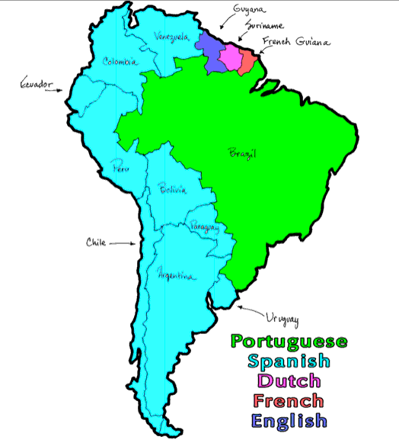
History and Government
Spanish & Portuguese first to colonize S.A.
By mid-1800s, most countries had achieved their independence from Europe
Divided into 12 sovereign nations (govern themselves independently), plus overseas administration of French Guiana

Slide 11
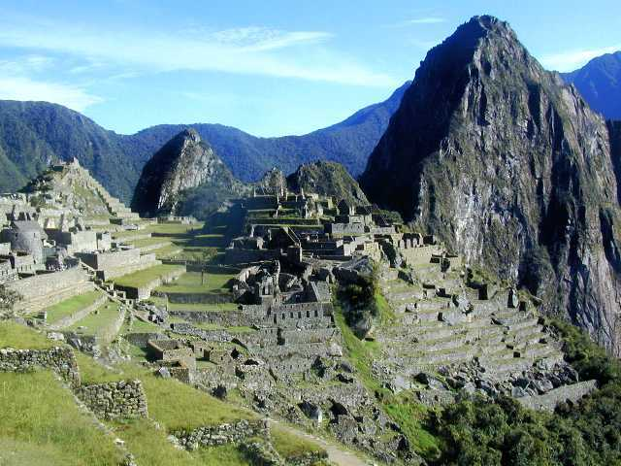
Incan Civilization
One of the oldest in S.A.
Capital of Cusco is in the Andes
known for distinct & developed culture
Conquered by Spanish invaders, led by Francisco Pizarro in 1533

Slide 12
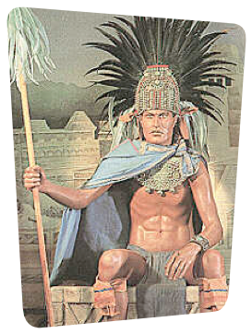
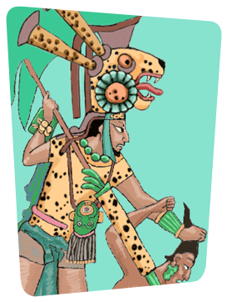
Maya—Mexico, Belize, Guatemala, El Salvador, Honduras (2500 BCE -1500 CE)
Inca—Peru, Bolivia, and Ecuador (12th Century)
Aztec—Mexico (12th Century)
The Three Native Civilizations
found in South America

Slide 13
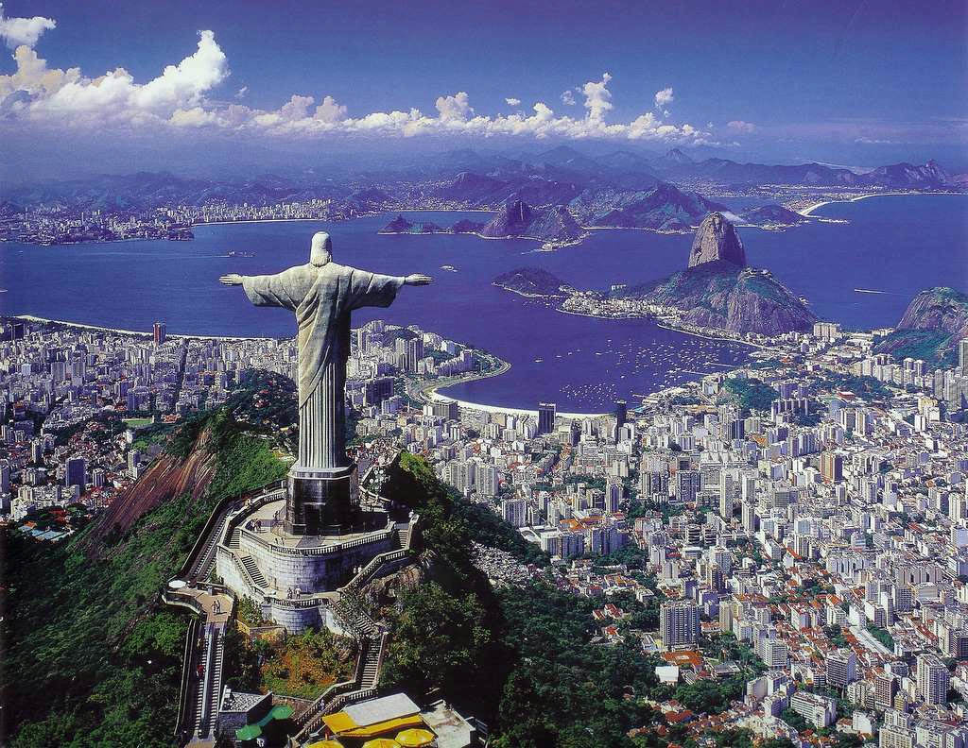
Culture
Christ the Redeemer
Influenced by the arts, traditions,& beliefs of indigenous peoples, Europeans, & Africans
Religion—mainly Catholic
Language—Spanish, Portuguese (Brazil), Dutch, French
Leisure—soccer (futbol) is a major sport
Population—mostly located around the coast

Slide 14
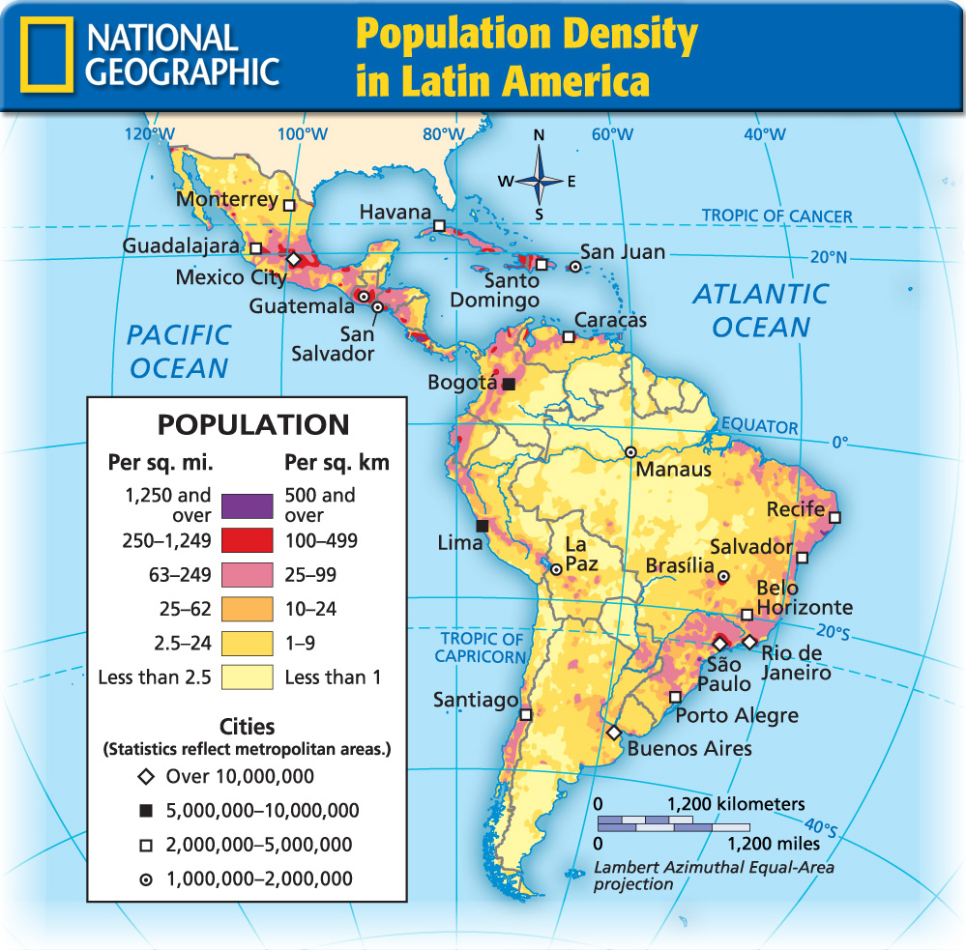

Slide 15
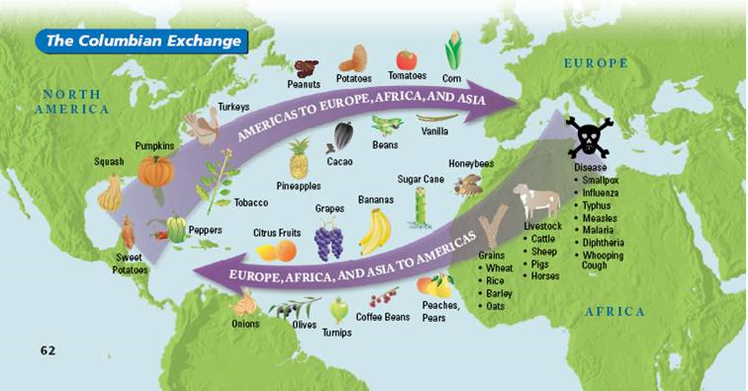
Columbian Exchange
Exchange of animals, plants, culture, human populations, disease, & ideas between the Old World (Europe) and New World (Americas)

Slide 16
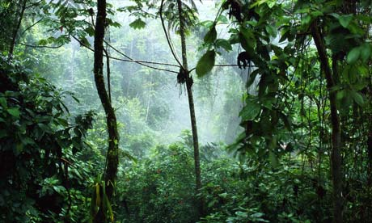
Amazon Rainforest
Largest rainforest in the world
10 percent of the world’s known species
Deforestation & drought are major issues

Slide 17
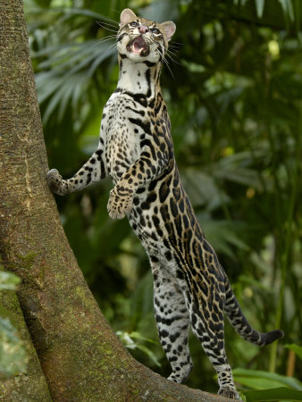
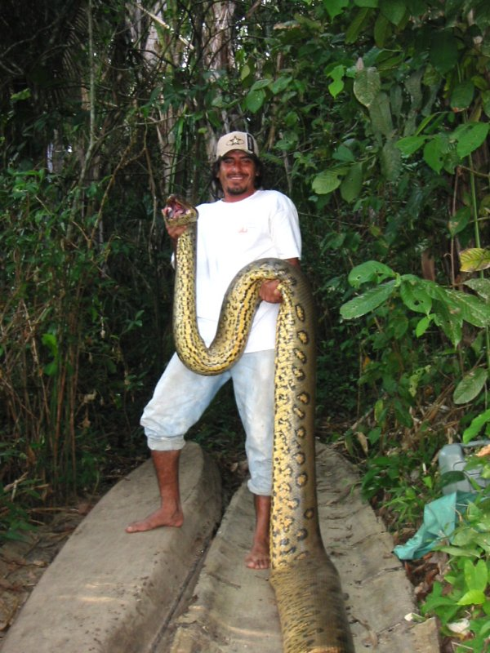
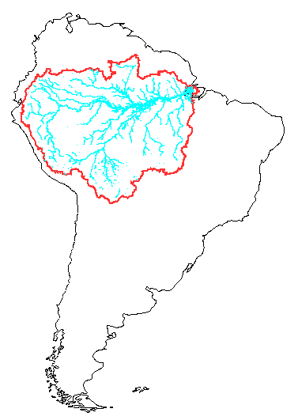
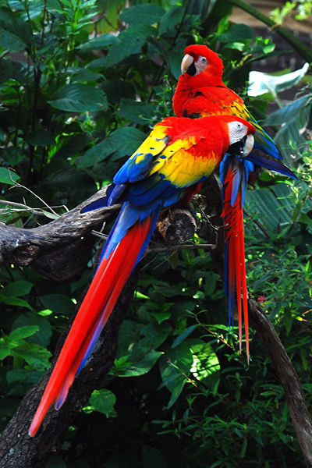
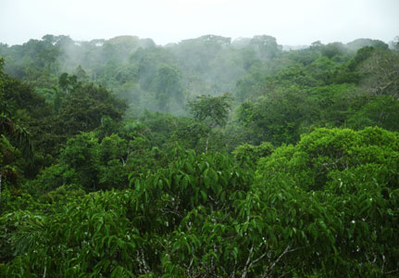
Another lowland area in Latin America is the Amazon Basin.
LOWLANDS
The Amazon Basin is the worlds largest rain forest occupying 40% of South America.

Slide 18
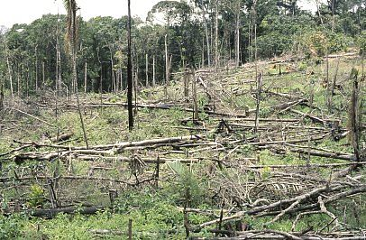
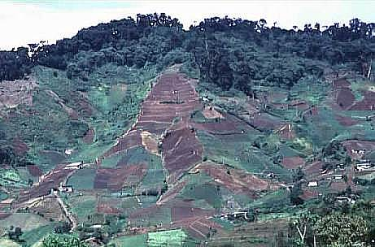
Deforestation in the Amazon

Slide 19
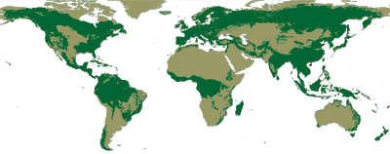
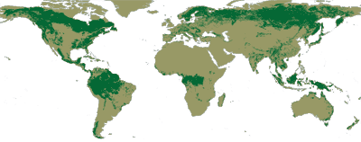
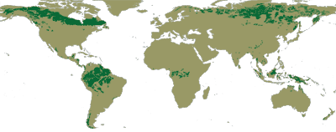
Original Forest Cover
Current Forest Cover
Future Forest Cover

Slide 20
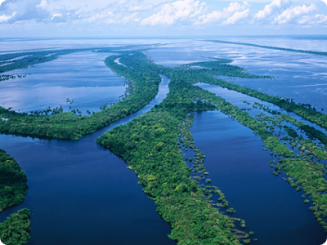
Amazon River
2nd largest river in the world
Water comes from the Andes Mountains
20 percent of water that pours out of the planet’s rivers into the oceans comes from the Amazon
Used for agriculture &transportation

Slide 21
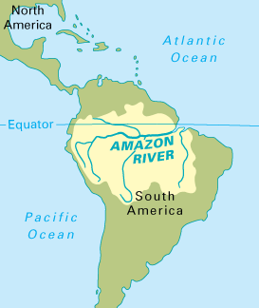
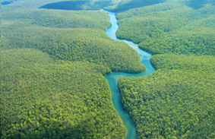
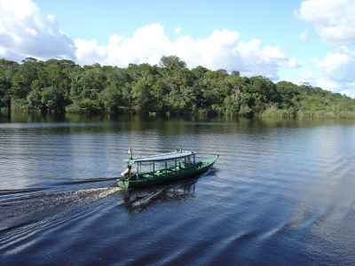
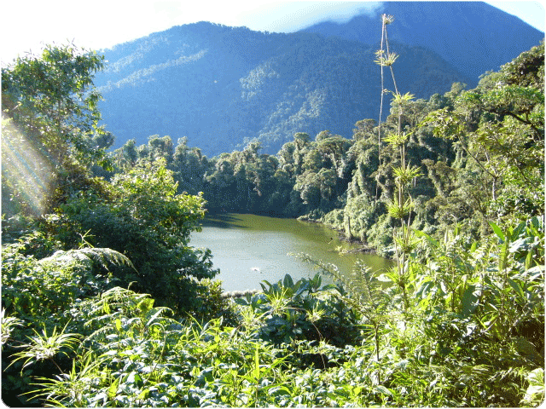
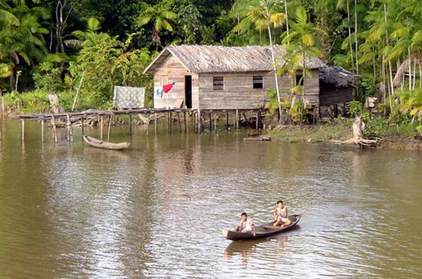
AMAZON RIVER
The Amazon is the largest river in the world. It begins in the Andes Mountains in Peru and flows east across Brazil. It is 4,000 miles long.

Slide 22
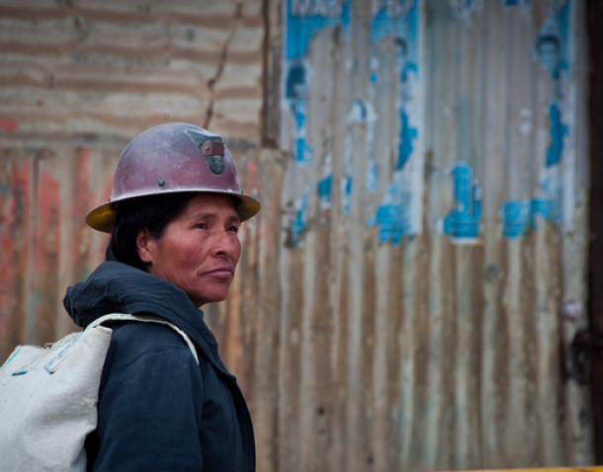
Economy
Industry:
Mining—Bauxite (mineral for making aluminum; from Guyana & Suriname)
Fishing
Oil
Subsistence farming
Exporters of:
Coffee, soybeans, wheat, corn, sugarcane, rice, etc.
Wool and leather products

Slide 23
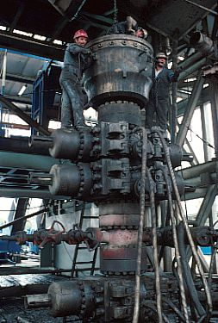
Oil Drilling in the Gulf of Mexico

Slide 24
Drug Trafficking Routes

Slide 25
Eco-Tourism

