Slide 1
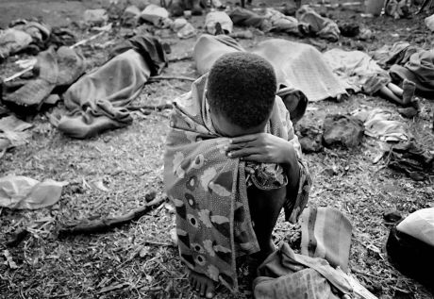
Rwandan Genocide

Slide 2
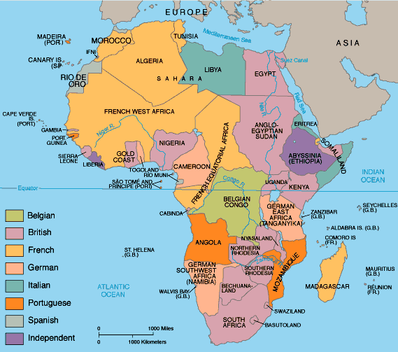
I
m
p
e
r
i
a
l
i
s
m

Slide 3
Leopold and the Division of Hutus and Tutsi’s
Hutu’s and Tutsi’s are the two major ethnic groups of the Congo
Belgians gave the Tutsi’s (minority) some power because they were “more civilized” than the Hutu’s
Tutsi’s oppressed the Hutu’s
Hutu’s eventually fought back and oppressed the Tutsi’s

Slide 4
How are they different?
Tutsi’s were said to be taller and have thinner noses
Belgians forced Hutu and Tutsi to carry identification cards stating their ethnic identity
Only allowed Tutsi to get a higher education and hold positions of power

Slide 5
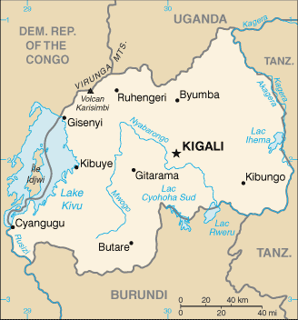
Independence
1962: the Congo gained its independence and split into two countries: Rwanda and Burundi

Slide 6
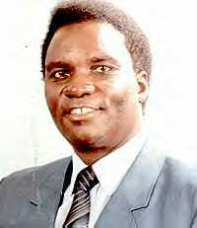
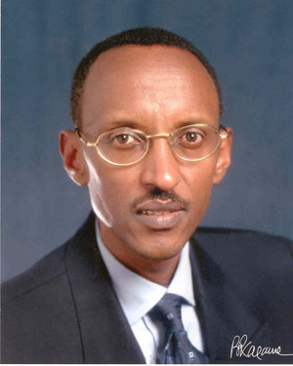
Conflict
Hutu majority took control in Rwanda
Tutsi’s formed the Rwandan Patriotic Front in Uganda led by Paul Kagame
The final straw for the Hutu came when President Juvenal Habyarimana’s plane was shot down on April 6, 1994

Slide 7
Oppress the Hutu
Hutu
Tutsi’s
Put in power by
The Belgians
Rise up and oppress the
Tutsi’s

Slide 8
Ethnic Groups
Hutu (Bantu)- 84%
Tutsi (Hamitic)- 15%
Twa (Pygmy)- 1%

Slide 9
Rwanda
Just under 10 million people live in Rwanda making it the most densely populated country in Africa.
Life expectancy is around 49 years.
Birth rate is on average 5.37 per woman.
Literacy rate is just over 70%.

Slide 10
Rwandan Genocide
Hutu killed friends, neighbors, schoolmates, murdering mostly Tutsis and some moderate Hutus
1 million innocent people slaughtered in under 100 days
The world did not react; watched it happen

Slide 11
Genocide
Genocide—the systematic extermination of a group of people on the basis of a defining characteristic
Race
Religion
Ethnicity
After WWII, the international community decided genocide should never happen again
Established the Genocide Convention in 1948 which legally defined genocide & obligates countries that sign the treaty to intervene to stop genocide when it is occurring.

Slide 12
Warning: Photographs are graphic
Photo’s from TIME article: When the World Turned Its Back: James Nachtwey’s Reflections on the Rwandan

Slide 13
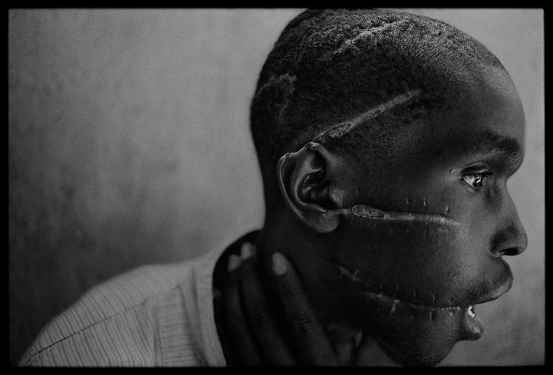
A Hutu man who did not support the genocide had been imprisoned in the concentration camp, starved and attacked with machetes. He managed to survive after he was freed and was placed in the care of the Red Cross, Rwanda, 1994

Slide 14
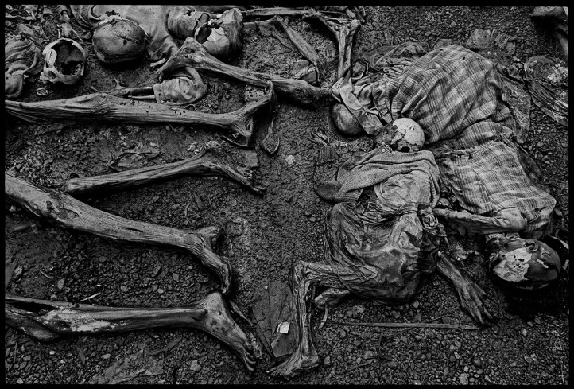
The massacre at Nyarabuye took place in the grounds of a Catholic Church and school. Hundreds of Tutsis, including many children, were slaughtered at close range, Rwanda, 1994.

Slide 15
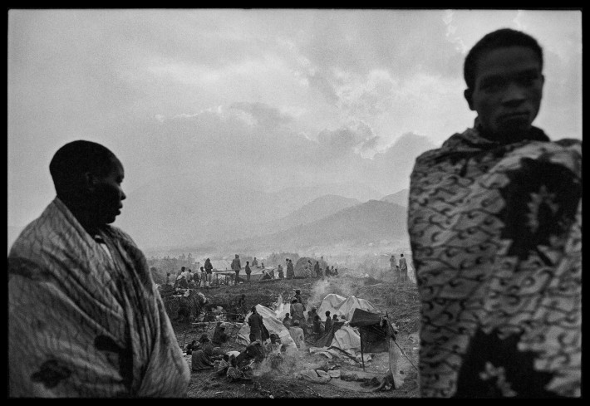
Hutus who fled into Zaire set up vast encampments in the plains below the volcanoes outside the town of Goma in 1994.

Slide 16
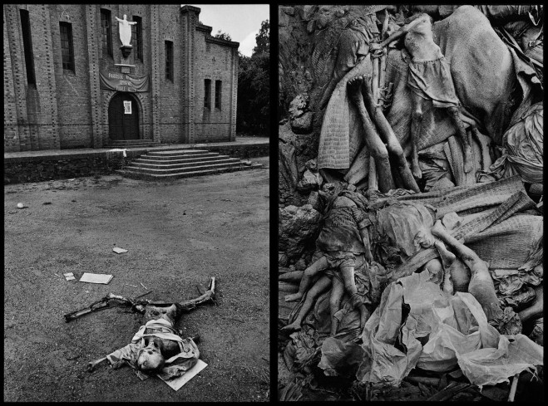
The massacre at Nyarabuye took place in the grounds of a Catholic Church and school. Hundreds of Tutsis, including many children, were slaughtered at close range in Rwanda, 1994 (left). Thousands were buried anonymously in mass, communal graves in Zaire, 1994 (right).

Slide 17
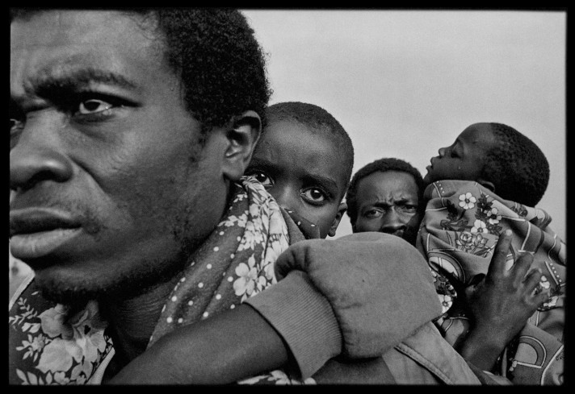
Sick children were carried by their fathers to a clinic in Zaire, 1994.

