Slide 1
Finals GRUDGEBALL
FEAR, ANGER, COMPETITION

Slide 2
RULES
Split your class into 5 teams
Each group gets a question. If they get it right they automatically get to erase two X's from the board. They can take it from one team or split it. They can not commit suicide (take X's from themselves).
Before they take off these X's, though, they have a chance to increase their ability to get the other teams to hate them. They get to shoot the ball. There are two lines. One is a one point line while the other is a two pointer.
If you make the shot, take an additional 1 or 2 X’s away.
5. If a team is eliminated, you have to get a question correct
AND make a shot, you get 4 X’s back.

Slide 3
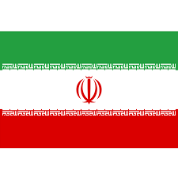
This country directly to the east of the Iraq.

Slide 4
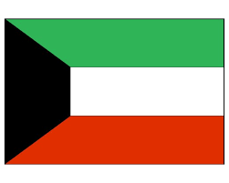
Country invaded by Iraq in the Gulf War.

Slide 5
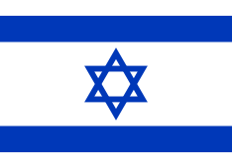
This country was founded in 1948.

Slide 6
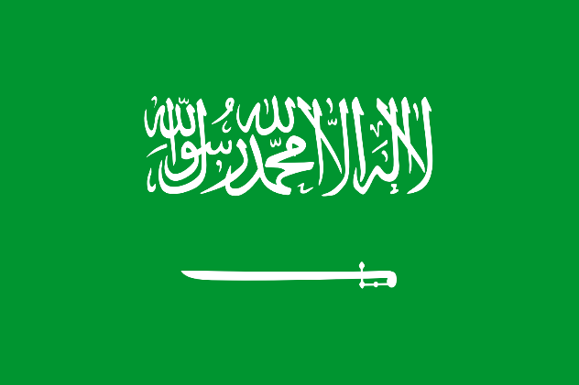
This country has the most holy city of Islam, Mecca.

Slide 7
This country is east of Iran and north of Pakistan.

Slide 8
This country was led by Saddam Hussein and invaded Iraq.

Slide 9
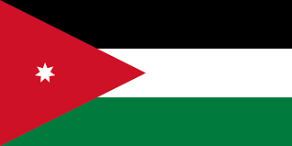
This country to the east of Israel holds many Palestinian refugees.

Slide 10
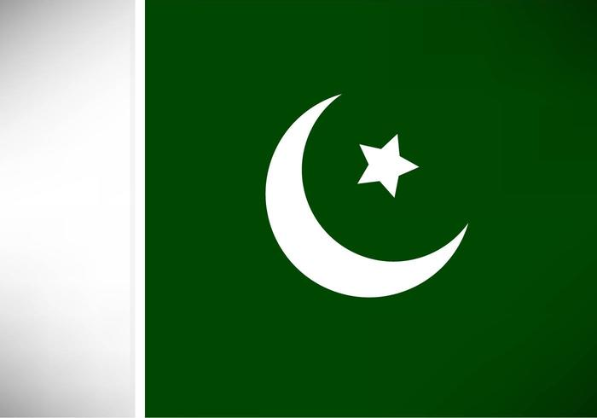
This country shares a western border with Iran and a northern border with Afghanistan.

Slide 11
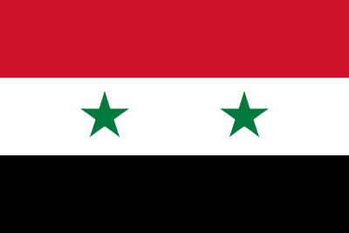
This country is currently experiencing a civil war and a refugee crisis.

Slide 12
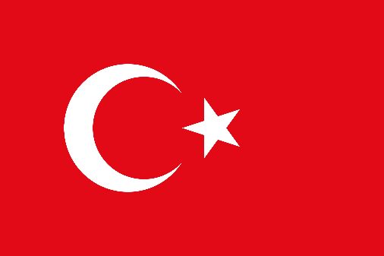
This country borders Europe and the Mediterranean Sea.

Slide 13
For which religion is this the symbol?
Christianity
Islam
Judaism
Buddhism
Sikhism

Slide 14
For which religion is this the symbol?
Christianity
Islam
Judaism
Buddhism
Sikhism

Slide 15
For which religion is this the symbol?
Christianity
Islam
Judaism
Buddhism
Sikhism

Slide 16
For which religion is this the symbol?
Christianity
Islam
Judaism
Buddhism
Sikhism

Slide 17
For which religion is this the symbol?
Christianity
Islam
Judaism
Buddhism
Sikhism

Slide 18
Abraham and Moses are considered the founders of what religion?

Slide 19
Jesus of Nazareth and Paul the Apostle are related to what religion?

Slide 20
Siddhartha Gautama is the most important figure in what religion?

Slide 21
Brahma, Vishnu, and Shiva are all gods associated with what religion?.

Slide 22
Muhammad is the most revered prophet is what religion?

Slide 23
What religion is the most prevalent in India?

Slide 24
What religion is most prominent in the Arab World?

Slide 25
What religion has a capital in the Vatican City and follows this man? (Be specific)

Slide 26
What religion considers the Wailing Wall in Jerusalem a holy site?

Slide 27
The followers of Confucius mostly live in what country?

Slide 28
What is the term for the movement to establish a homeland for the Jews in the Middle East?

Slide 29
Name one of the two areas that most Palestinians live

Slide 30
What is the city that is at the center of the Israeli/Palestinian Conflict?

Slide 31
What is the term for people that flee their homeland for safety from conditions that exist there?

Slide 32
What is the name of the short war between Israel and its Arab neighbors in 1967?

Slide 33
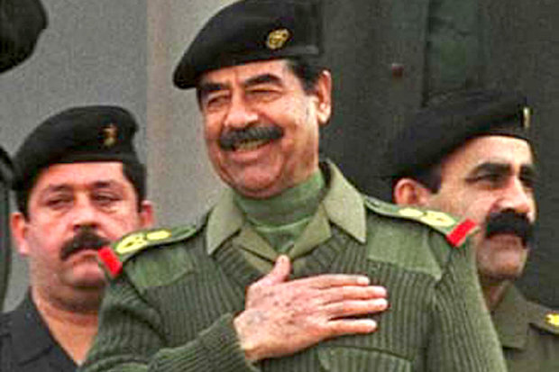
Saddam Hussein was the former dictator of what country?

Slide 34
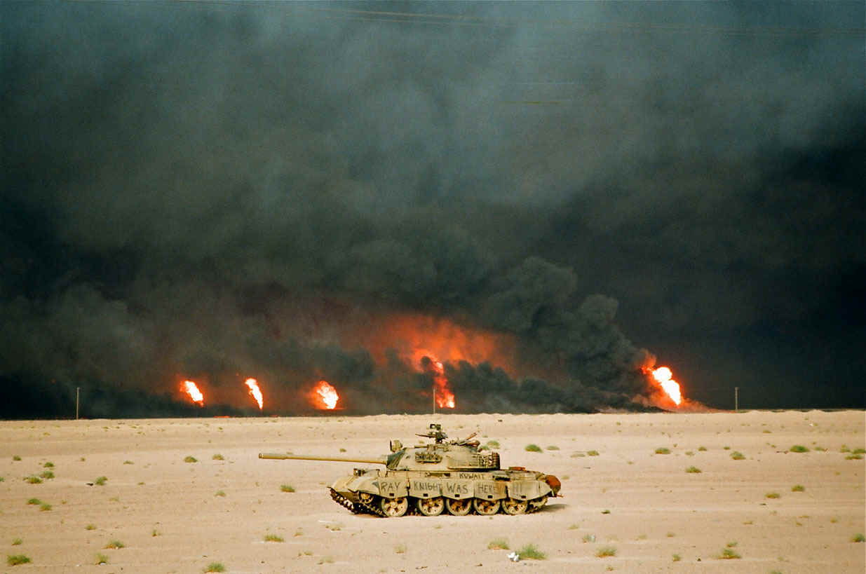
What was the name of the United States military operation to liberate Kuwait?

Slide 35
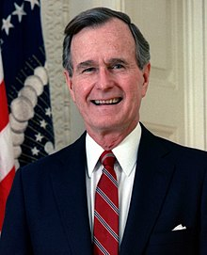
Who was the President of the United States during the Persian Gulf War?

Slide 36
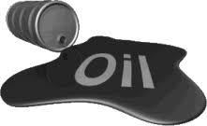
Why did Iraq invade Kuwait in the first place? (Small Hint)

Slide 37
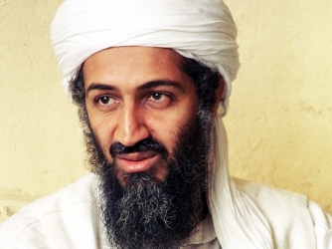
What international terrorist will begin his campaign against the United States after the Gulf War?

Slide 38
In what country did the Arab Spring start?

Slide 39
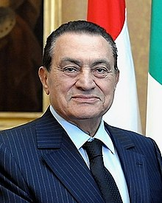
Hosni Mubarak was deposed as the leader of which country?

Slide 40
What specific event in Tunisia sparked the Arab Spring?

Slide 41
What was a goal of the Arab Spring?

Slide 42
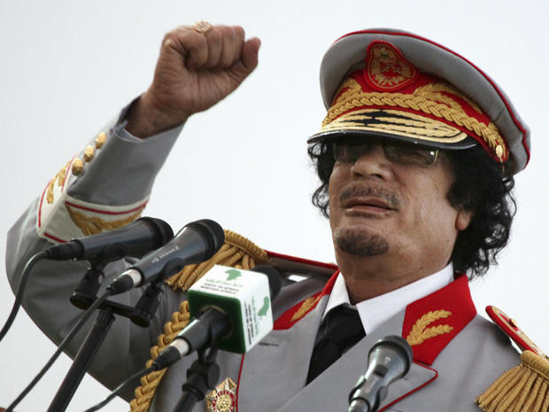
Mohammar Qaddafi was deposed as the leader of which country?

Slide 43
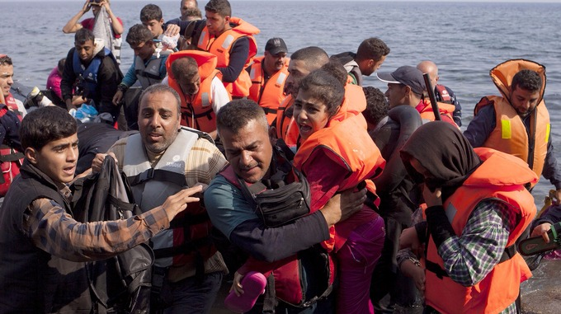
Why is the Syrian Civil War a humanitary crisis?

Slide 44
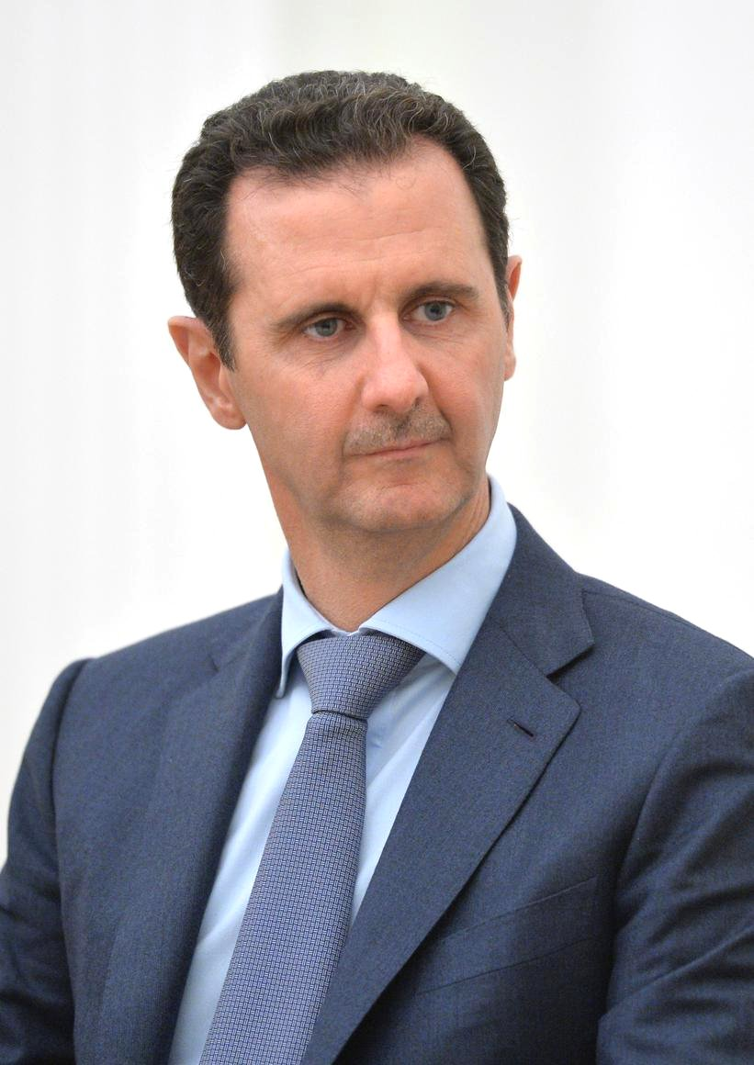
What is the name of the President of Syria?

Slide 45
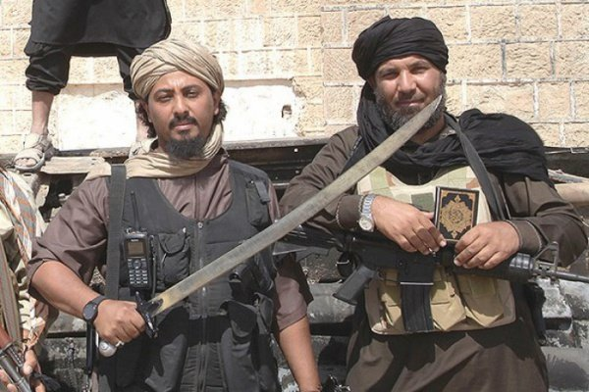
What is the name of the terrorist organization that has made Syria it’s home?

Slide 46
What illegal weapons did President Assad use during the Civil War?

Slide 47
How did the United States react to the use of illegal weapons in Syria?

Slide 48
What event cause rioting in Jerusalem a few weeks ago?

Slide 49
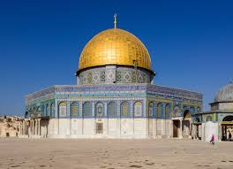
What religion holds the “Dome of the Rock” sacred in Jerusalem?

Slide 50
What religion has the most followers around the world?

Slide 51
What religion dominates South America?

Slide 52
Which of the religions we discussed has no concept of a God?

