Slide 1
DO NOW
List THREE examples of NON-VIOLENT RESISTANCE.
Summarize what happened in ONE of these examples

Slide 2
Video Link
goo.gl/N3cjzW

Slide 3
Learning Goals
EQ
What forms of protest did the Civil Rights Movement take?
LTs
I can explain the goals and methods of Martin Luther King, Jr. and Malcolm X.
I can compare and contrast the views of MLK and Malcolm X.
POU
Compare and contrast the views of MLK and Malcolm X by completing a Venn diagram and analyzing primary source videos.

Slide 4
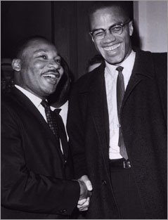
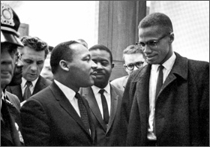
Martin Luther King & Malcolm X
Two men with the same goal, but a different approach.
Objective:
1. Compare and contrast the ideologies of Malcolm X and MLK.
SOURCE:
http://arapahoe.littletonpublicschools.net/Portals/7/Social%20Studies/Levi/US/Unit%208/Malcolm%20and%20Martin.ppt

Slide 5
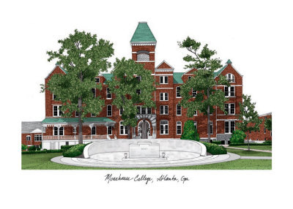
Martin Luther King’s Early Life
Son of a Baptist Minister from Atlanta
Attended Morehouse College and graduated from Boston University with a Ph.D.
Became a pastor in Montgomery, Alabama at the age of 24.

Slide 6
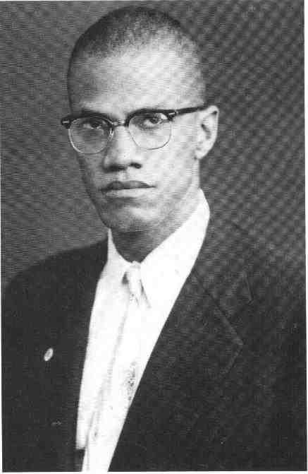
Malcolm X’s Early Life
Father was killed because he was a civil rights activist
Went to prison for 6 years for gambling, racketeering, & robbery
Converts to Islam in prison, after his release he becomes a minister for the Nation of Islam
Changes his last name to “X” because “Little” was a “slave name”

Slide 7
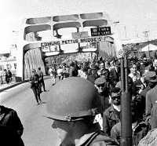
Martin Luther King’s Ideology
Expose the racism, prejudice, discrimination, & brutality that existed in the South
Use non-violent means to promote the change he wanted.

Slide 8
Malcolm X’s Ideology
Believed African-Americans should stand up and fight for their freedom
Believed violence was necessary to earn freedom
Believed that the Christian religion was based on the white culture

Slide 9
King’s Movement
Southern Christian Leadership Conference
Organized black churches to conduct non-violent protests
Used media coverage to expose Jim Crow laws
King would later win the Nobel Peace Prize.
Achieved legislation (Voting Rights Act and Civil Rights Act)

Slide 10
Malcolm X’s Movement
Member of the Nation of Islam
Taught that Africans belonged at the top of the social order
“Whites” only took advantage of the black race
Wanted political and economic black independence
He would later leave the Nation of Islam and change his view on Whites and Blacks

Slide 11
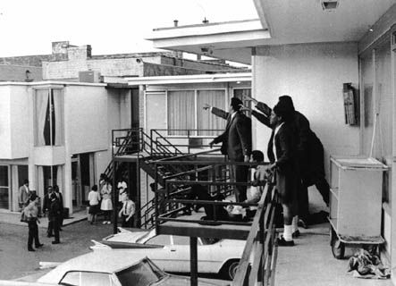
Assassinations
Martin Luther King
Achieved legislation (Voting Rights Act and Civil Rights Act)
He was shot outside a hotel in Memphis, Tennessee in 1968
Malcolm X
Tensions arose between Malcolm and the Nation of Islam
He was shot 16 times during a speech in 1965

Slide 12
Quotes
Dr. King on Integration
“I have a dream that one day on the red hills of Georgia the sons of former slaves and the sons of former slave owners will be able to sit down together at the table of brotherhood.”
“A genuine leader is not a searcher for consensus but a molder of consensus.”

Slide 13
Quotes
Malcolm X on Integration
"If I have a cup of coffee that is too strong for me because it is too black, I weaken it by pouring cream into it. I integrate it with cream. If I keep pouring enough cream in the coffee, pretty soon the entire flavor of the coffee is changed; the very nature of the coffee is changed. If enough cream is poured in, eventually you don't even know that I had coffee in this cup.
“This is what happened with the March on Washington. The whites didn't integrate it; they infiltrated it. Whites joined it; they engulfed it; they became so much a part of it, it lost its original flavor. It ceased to be a black march; it ceased to be militant; it ceased to be angry; it ceased to be impatient. In fact, it ceased to be a march."

Slide 14
Quotes
Malcolm X on Dr. King
“He got the peace prize, we got the problem. ... If I'm following a general, and he's leading me into a battle, and the enemy tends to give him rewards, or awards, I get suspicious of him. Especially if he gets a peace award before the war is over.”
“Dr. King wants the same thing I want - freedom!”

Slide 15
Quotes
Dr. King on Malcolm X
"You know, right before he was killed he came down to Selma and said some pretty passionate things against me, and that surprised me because after all it was my territory there. But afterwards he took my wife aside, and said he thought he could help me more by attacking me than praising me. He thought it would make it easier for me in the long run."

Slide 16
Quotes
Dr. King on Violence & Power
“Have we not come to such an impasse in the modern world that we must love our enemies - or else? The chain reaction of evil - hate begetting hate, wars producing more wars - must be broken, or else we shall be plunged into the dark abyss of annihilation. “

Slide 17
Quotes
Malcolm X on Violence and Power
“Who ever heard of angry revolutionists all harmonizing ‘We shall overcome ... Suum Day…’ while tripping and swaying along arm-in-arm with the very people they were supposed to be angrily revolting against? Who ever heard of angry revolutionists swinging their bare feet together with their oppressor in lily-pad park pools, with gospels and guitars and ‘I have a dream’ speeches? And the black masses in America were - and still are - having a nightmare.”

Slide 18
End.

